Slide 1
Graphical models
Graphical models represent the interaction between variables visually - inference over a large number of variables can be decomposed into calculations involving a small number of variables - with the use of conditional independencies.

Slide 2
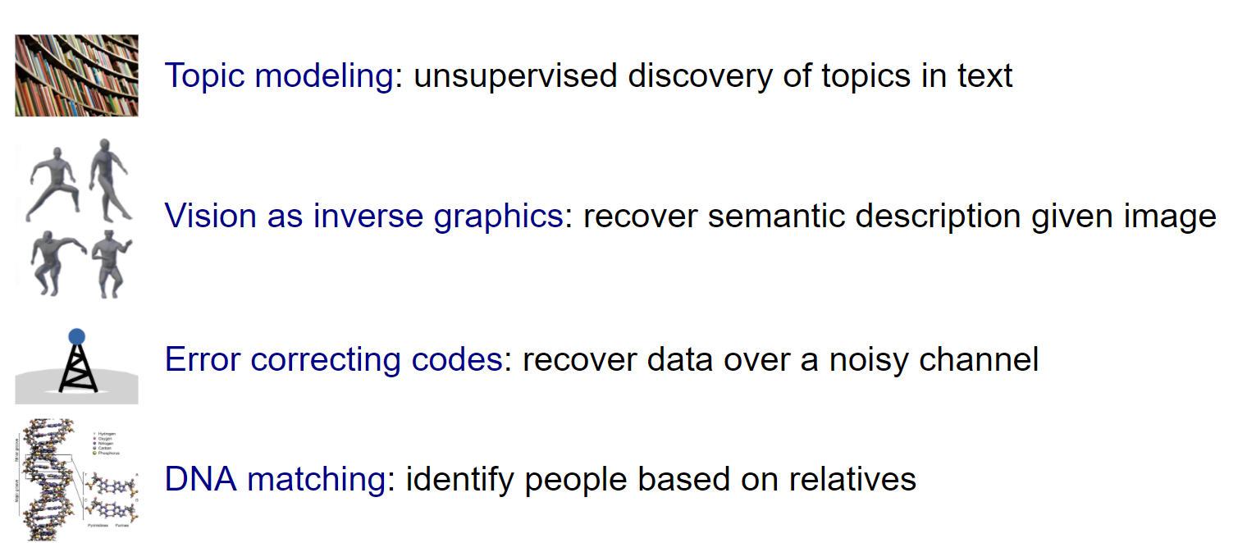
Applications

Slide 3
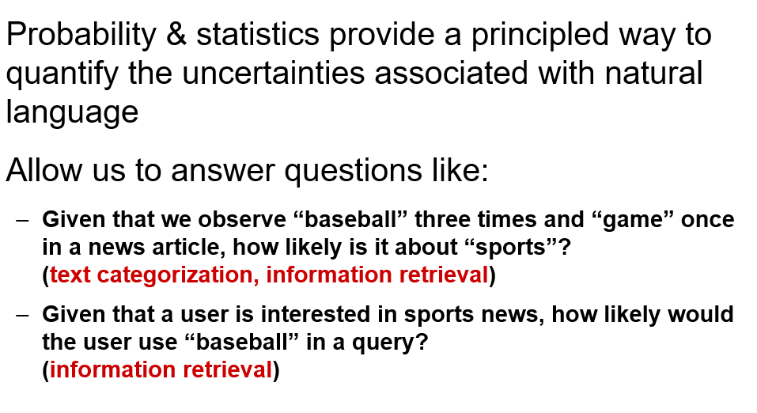
Recap of Probability

Slide 4
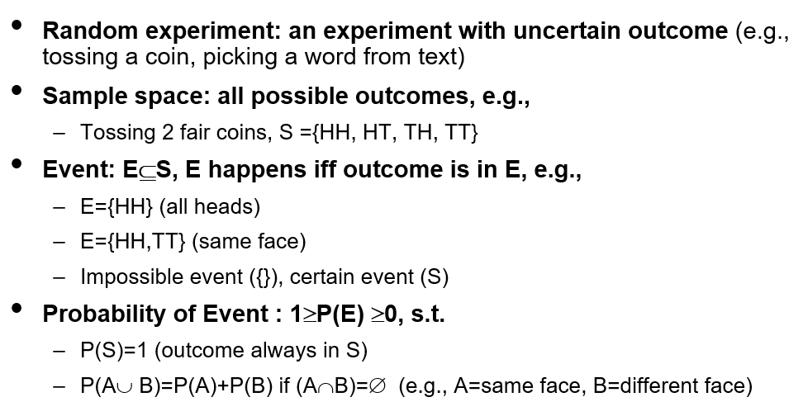
Basic concepts in Probability

Slide 5
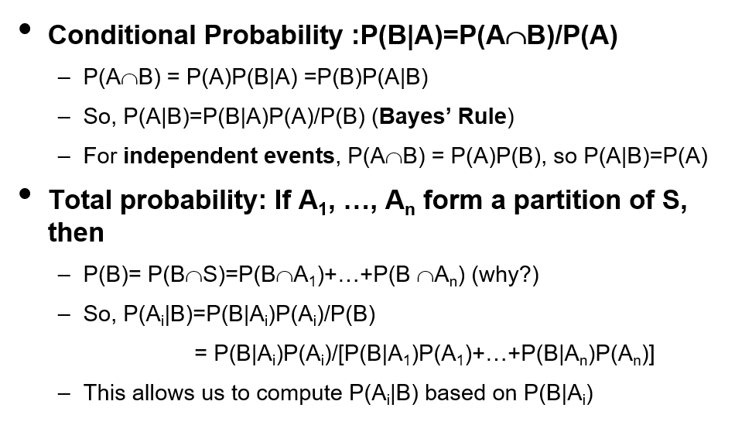
Basic concepts in Probability

Slide 6
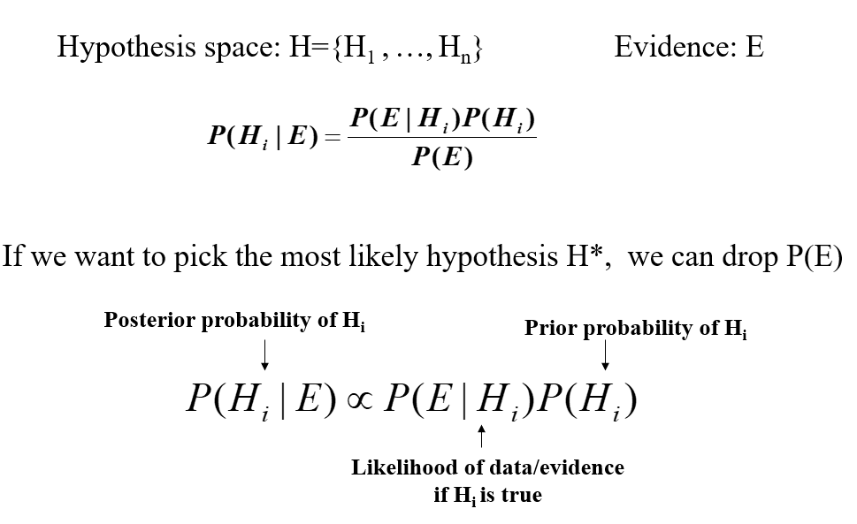
Bayes rule
Bayesianism is a measure of belief / weight of evidence

Slide 7
Network models under uncertainty
Bayesian Network (directed edges)
Markov Networks (undirected edges)

Slide 8
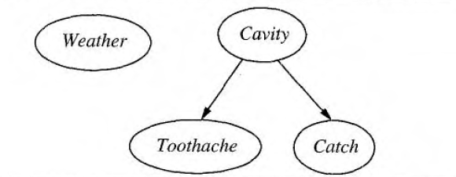
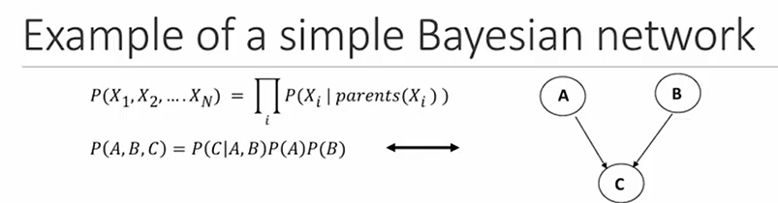
Bayesian Network

Slide 9
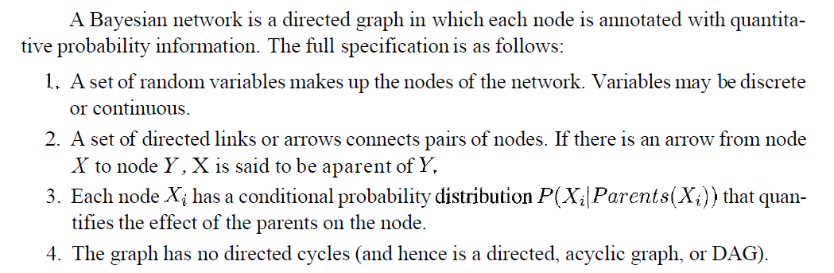
Bayesian Network

Slide 10
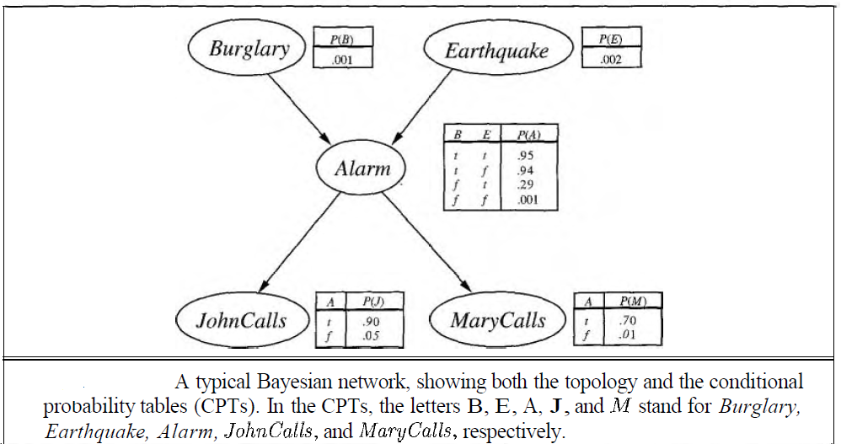
Bayesian Network

Slide 11
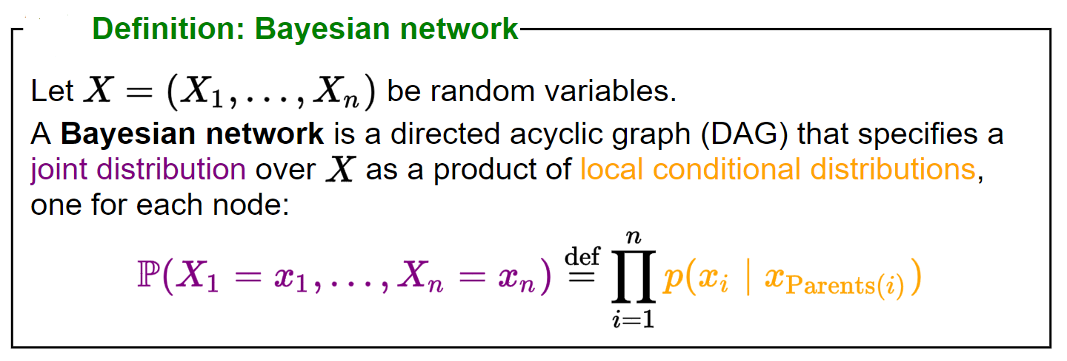

Slide 12
Semantics of Bayesian Network
Network representation
Conditional Independence

Slide 13

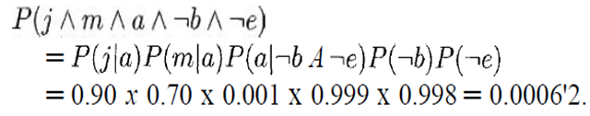
Representing full join distribution

Slide 14

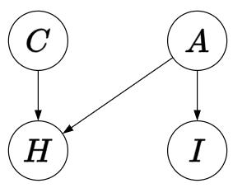
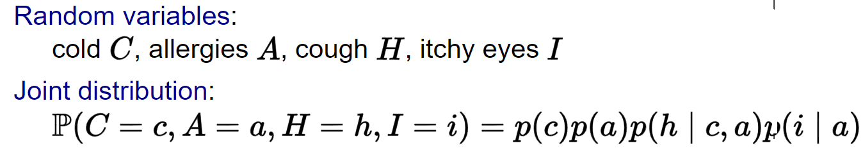

Slide 15
Inference in Bayesian Network
Exact Inference
Approximate Inference

Slide 16
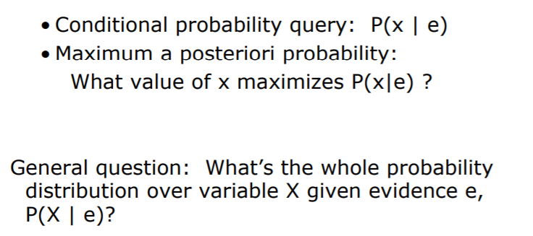
Exact Inference – inference by Enumeration
Find the posterior Probability distribution of query variables given some evidence
Conditional probability can be computed by summing terms from full joint distribution

Slide 17
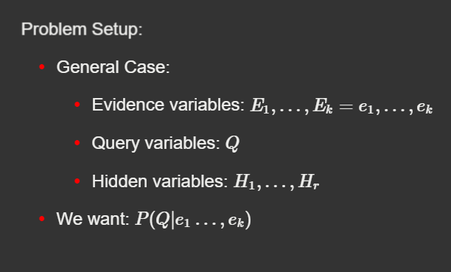
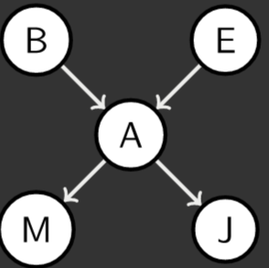

Exact inference
Q : B
E : +j , +m
H: A, E

Slide 18
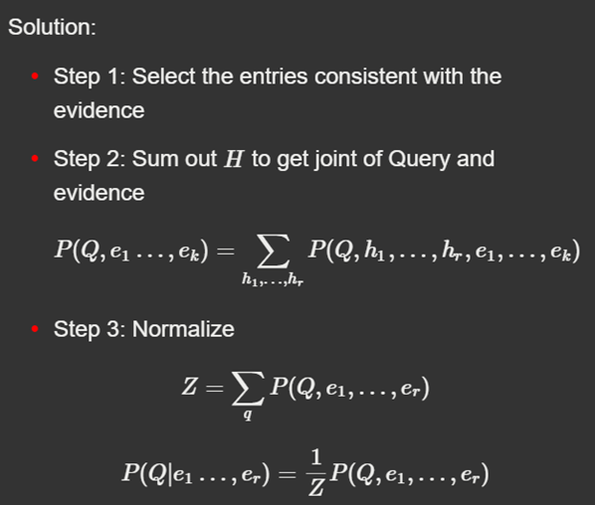
Solution

Slide 19
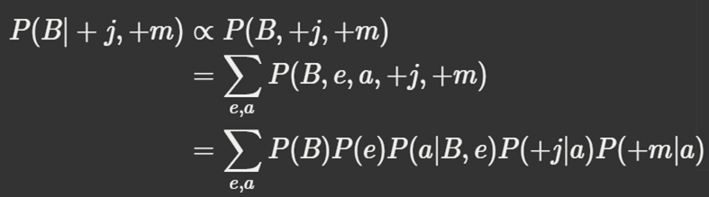

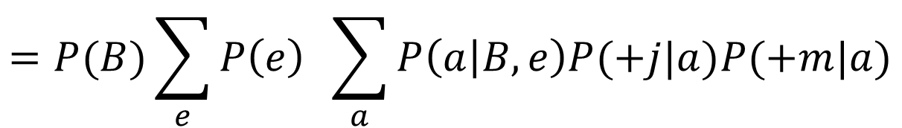
$$A=πr^{2}$$
$$=P(B)\sum_{e}{P\left(e\right) \sum_{a}{P\left(a | B,e\right)P(+j|a)P(+m|a)}}$$

Slide 20
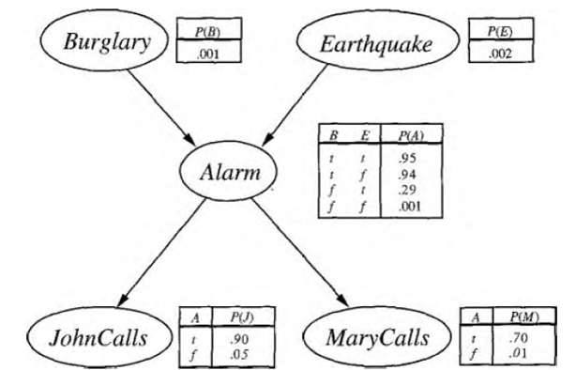
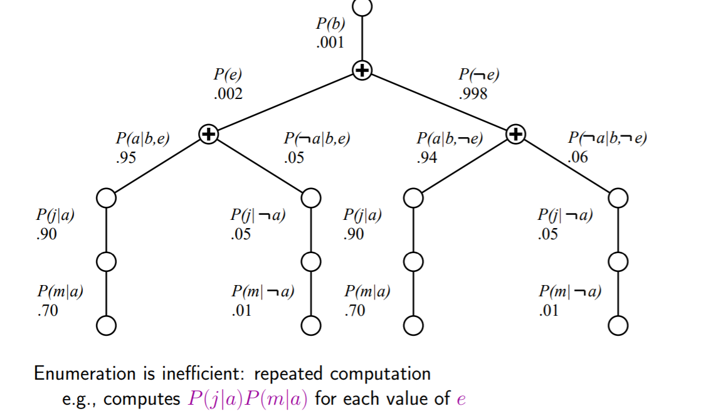
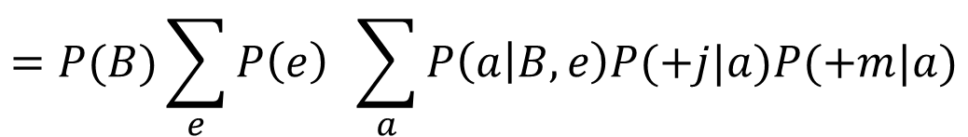
Evaluation Tree
$$=P(B)\sum_{e}{P\left(e\right) \sum_{a}{P\left(a | B,e\right)P(+j|a)P(+m|a)}}$$

Slide 21
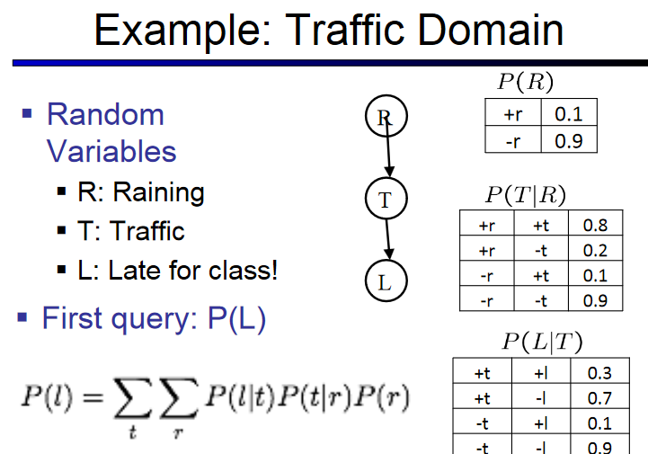

Slide 22
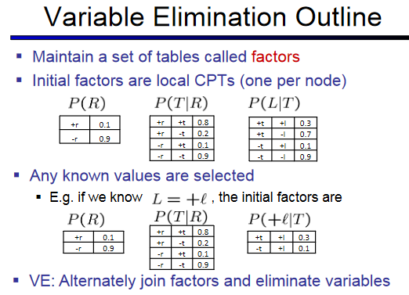

Slide 23
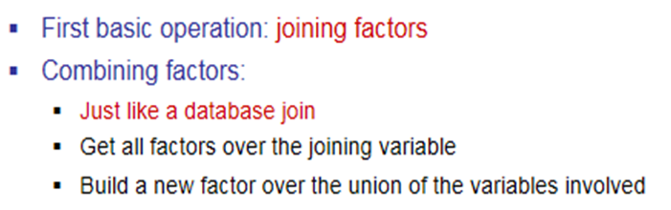
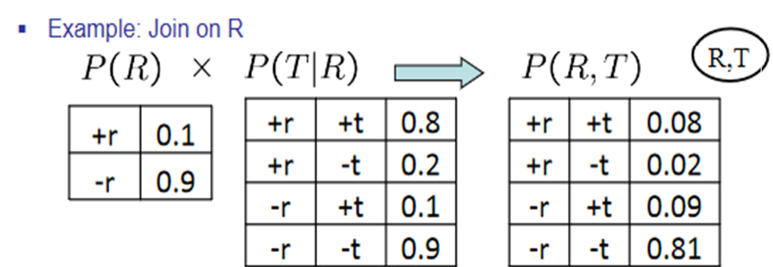


Slide 24
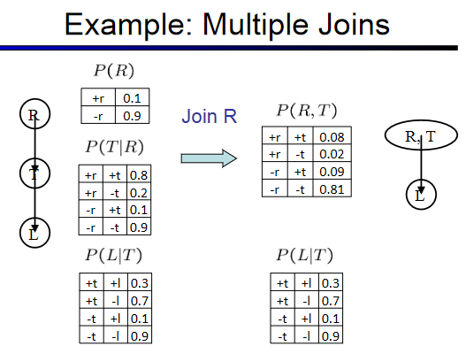

Slide 25
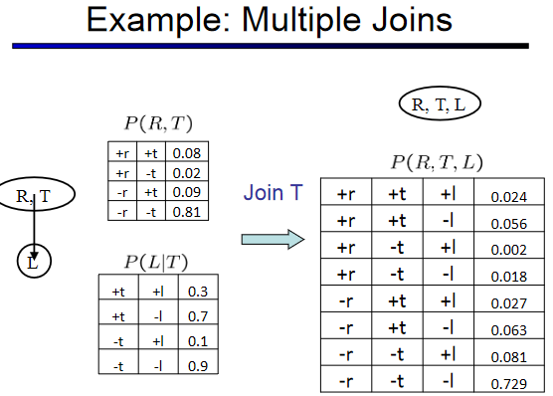

Slide 26
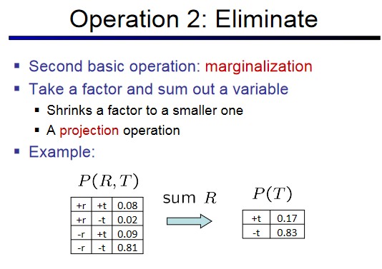

Slide 27
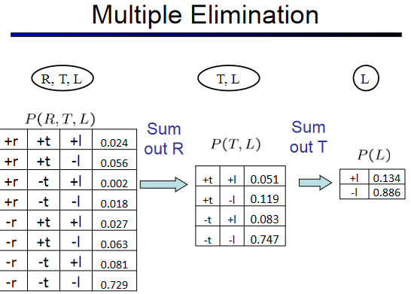

Slide 28
Thus so far …
Multiple join ,
Multiple Elimination =
Inference by enumeration

Slide 29
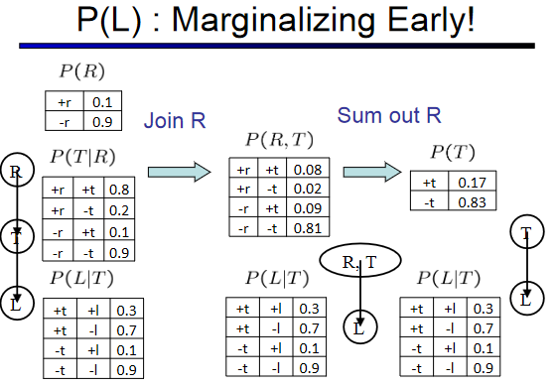

Slide 30
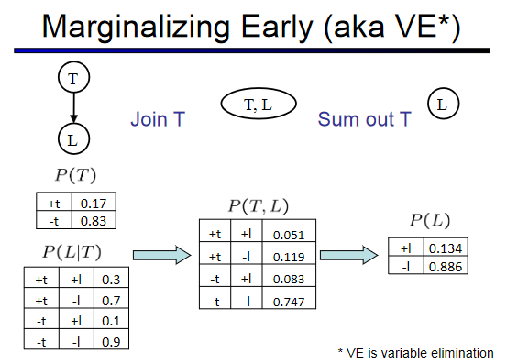

Slide 31
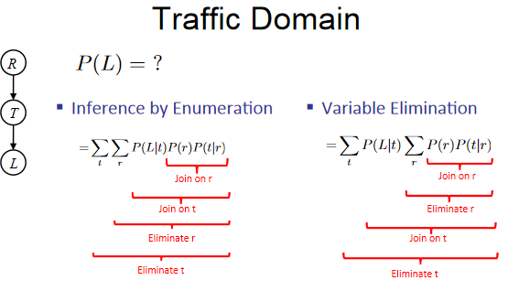

Slide 32
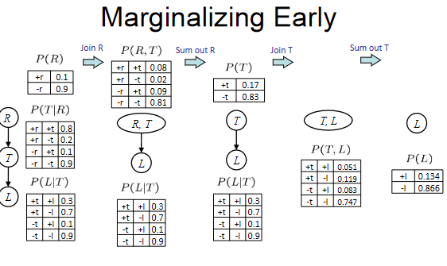

Slide 33
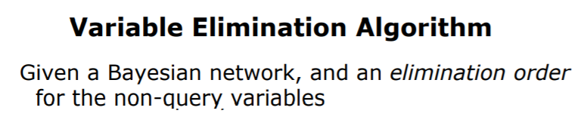
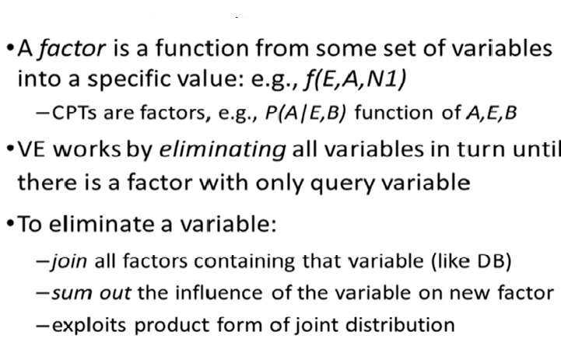

Slide 34
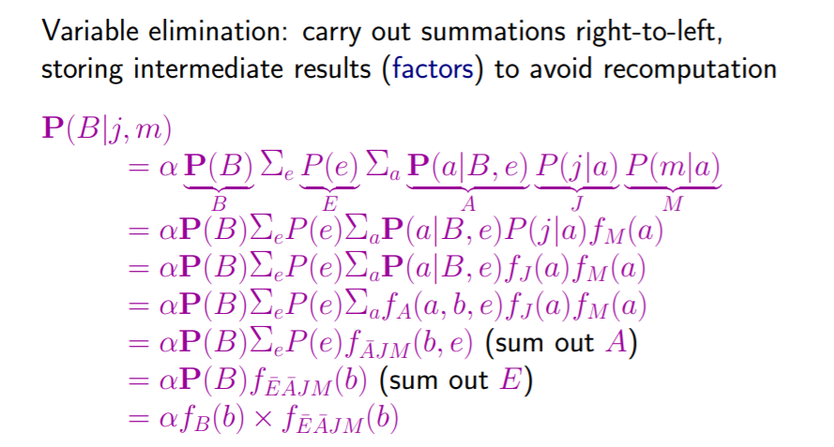
Variable Elimination

Slide 35

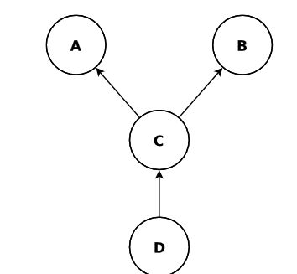

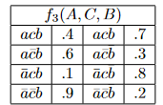

Question : Find P(A|B=t)

